Slide 1

Deep Learning - Seminar
Dayanand Sagar University
Name- Aman Thapa
USN- ENG19CS0026
Section- A

Slide 2
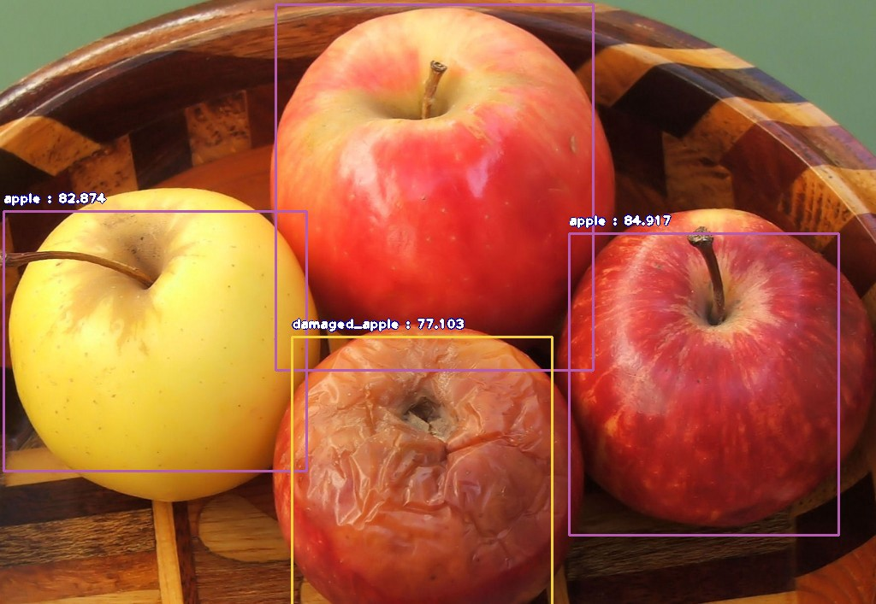
Topic
Fruits
Identification
System

Slide 3
Code
Github Link: -
https://github.com/aman-thapa/DeepLearning-College/tree/main/Fruits%20Identification%20System
Google Colab Link: -
https://colab.research.google.com/drive/1zROnEERWDZjq58pT1S3JSZtcu8E9p1bN?usp=sharing

Slide 4
Objectives
Dealing with Image datasets.
Performing Data Processing and Augmentation as and when required.
Creating and training a Convolutional Neural Network using Tensorflow 2.0.

Slide 5
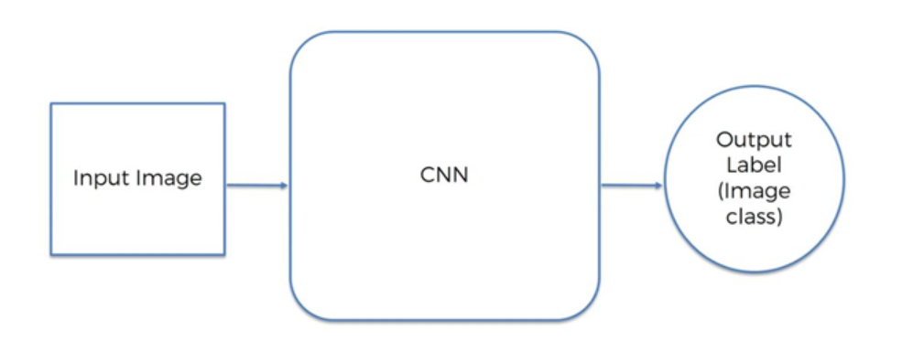
What is CNN?
A Convolutional Neural Network (ConvNet/CNN) is a Deep Learning algorithm which can take in an input image, assign importance (learnable weights and biases) to various aspects/objects in the image and be able to differentiate one from the other. The pre-processing required in a ConvNet is much lower as compared to other classification algorithms.

Slide 6
Approach
Build a small convolutional neural network.
Select images to train the convolutional neural network.
Extraction of feature filters/feature maps.
Implementation of the convolutional layer.
Apply the ReLu Activation function on the convolutional layer to convert all negative values to zero.
Then apply max pooling on convolutional layers.
Make a fully connected layer
Then input an image into CNN to predict the image content
Backpropagation to calculate the error rate

Slide 7
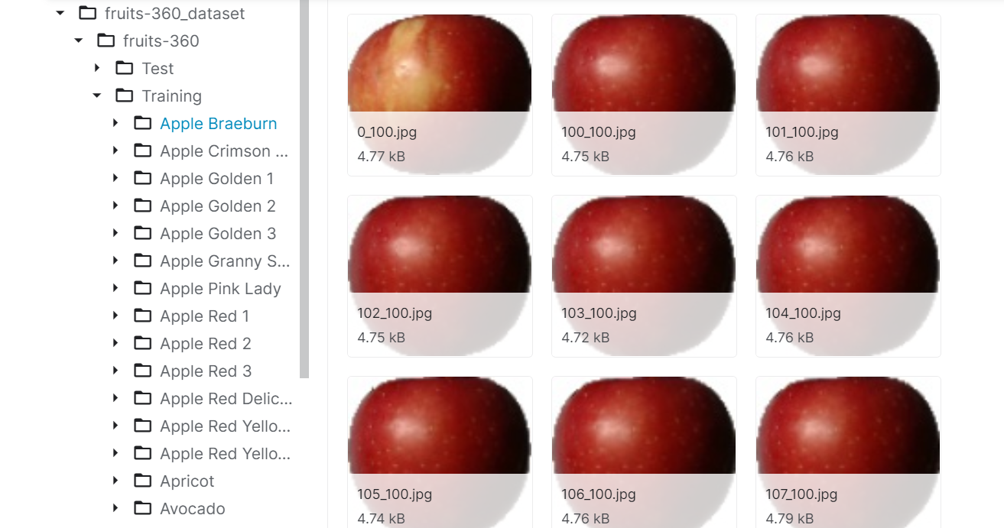
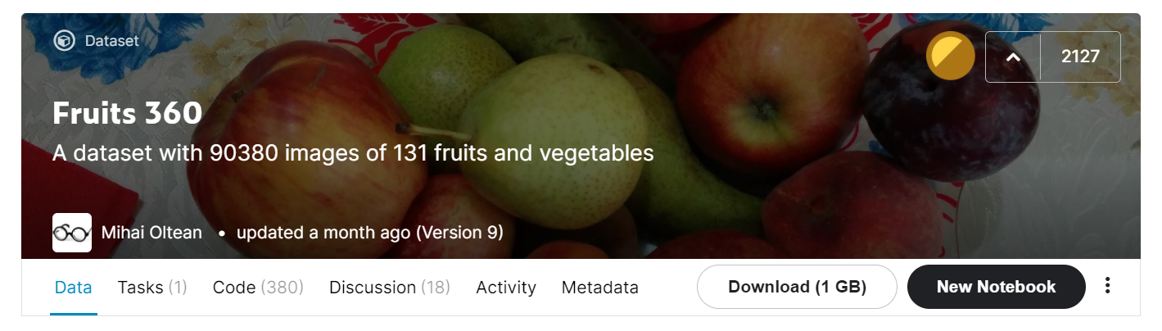
Dataset
Kaggle Dataset Link: -
https://www.kaggle.com/moltean/fruits
Download dataset in google colab: -
https://www.dropbox.com/s/fxn3ldztzwxm0rw/FruitsData.zip

Slide 8
Applying Data Augmentation
Inspite of all the data availability, fetching the right type of data which matches the exact use-case of our experiment is a daunting task. Moreover, the data has to have good diversity as the object of interest needs to be present in varying sizes, lighting conditions and poses if we desire that our network generalizes well during the testing phase. To overcome this problem of limited quantity and limited diversity of data, we generate(manufacture) our own data with the existing data which we have. This methodology of generating our own data is known as data augmentation.
To state a few of the frameworks, Keras has ImageDataGenerator (needs least amount of work from us), Tensorflow has TFLearn’s DataAugmentation and MXNet has Augmenter classes.

Slide 9
Trying Different Models
Models tensorflow currently supports: -
https://www.tensorflow.org/api_docs/python/tf/keras/applications
After evaluting three models which are RESNET50, INCEPTION V3 and EFFICIENTNETB3, we found that EFFICIENTNETB3 performed better. Hence, we will use this model for testing.
EfficientNet is a convolutional neural network architecture and scaling method that uniformly scales all dimensions of depth/width/resolution using a compound coefficient.

Slide 10
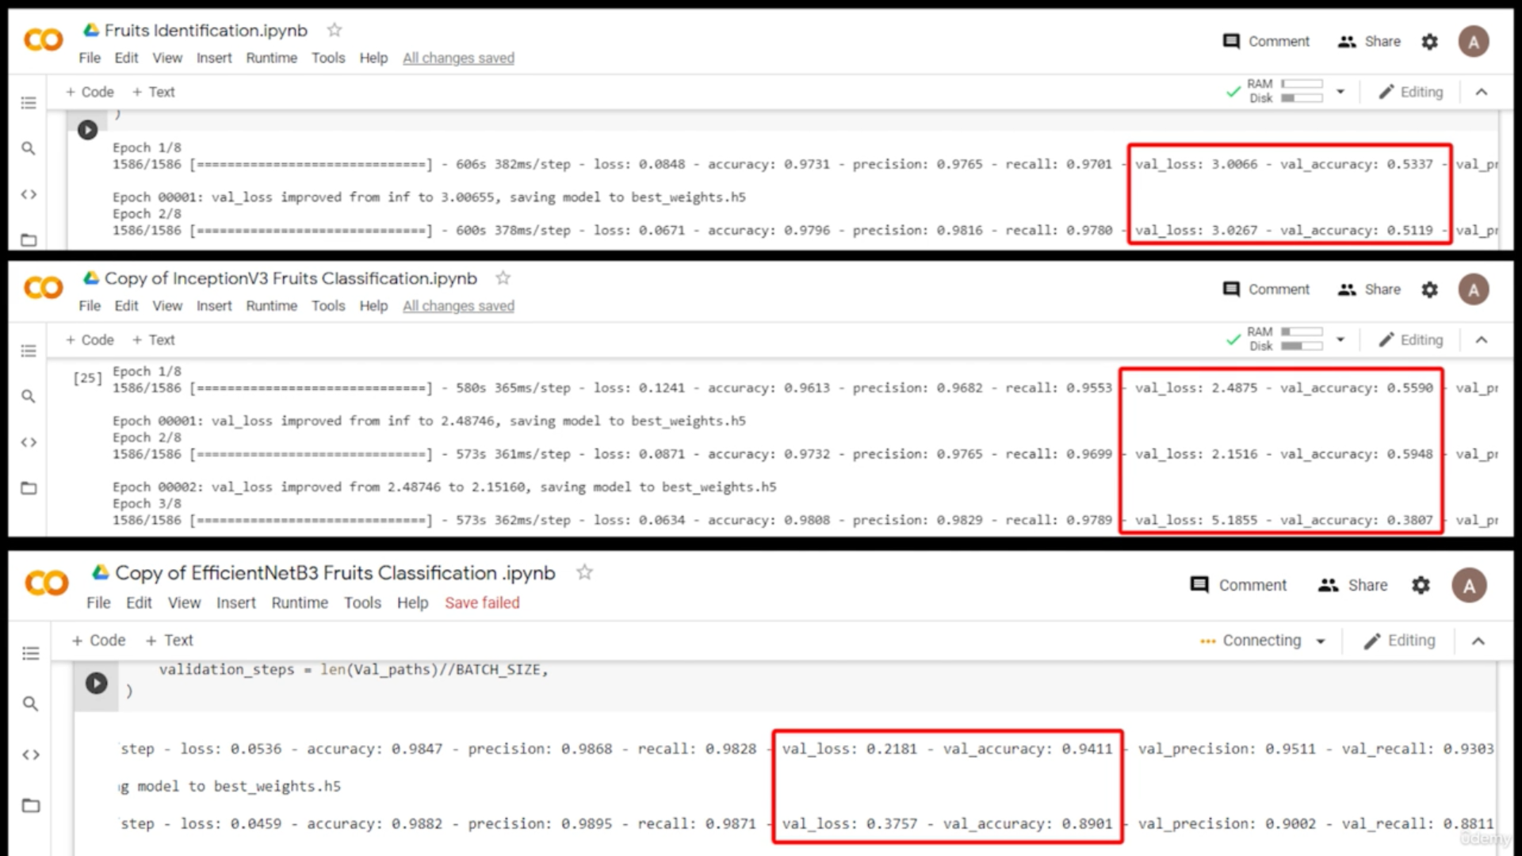

Slide 11
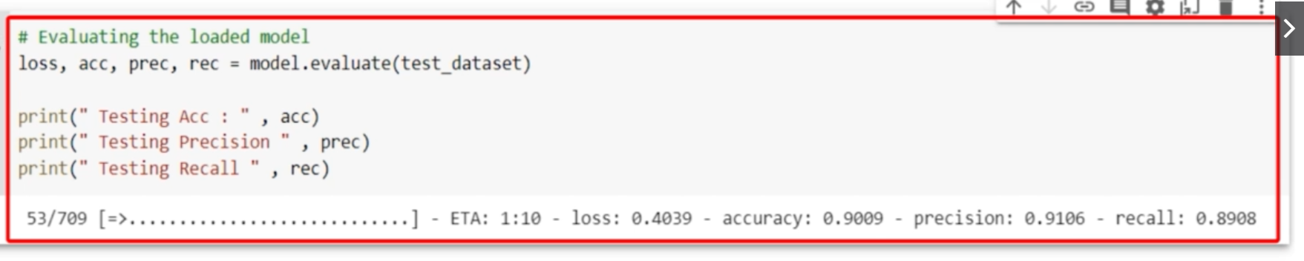
Evaluating Model
We get a good accuracy considering it was a large multiclass problem.

Slide 12
Real Time Prediction
We have built a model that can classify different types of fruits and vegetables, we can go ahead and make a simple application out of it.
For example - A customer would click an image with his phone and upload it in our application and we detect the fruit name and return it back to the customer.
For this we need to build a pipeline that takes an input as a single image and the output would be a string that tells the name of the fruit.

Slide 13
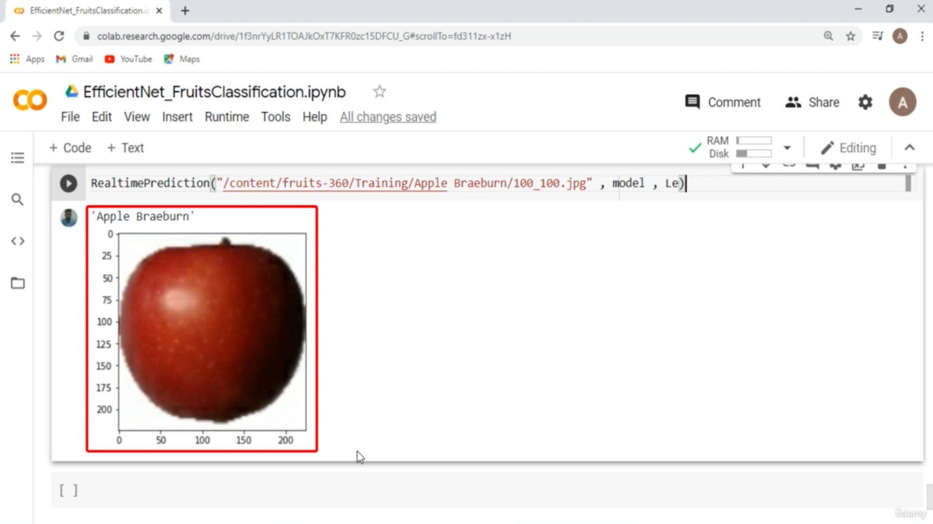
Sample
A random image path was passed and we got the ouput.

Slide 14
Ways to improve training results
Increasing the training by 1 more epoch.
Increase number of phases and decrease number of epochs per phase.
Use better version of EFFICIENTNET.

